Slide 1
Predicting the U-3 Labor Underutilization Rate: December 2025
Statistical Models for Data Science - Analysis Challenge
Team: Group 8
Devanshu Khadka, Mahima Goyal, Jiayi Hui, Sadaf Khan
Professor Ming-Long Lam

Slide 2
Business Problem
Financial markets react strongly to monthly labor data releases, especially unemployment figures
U-3 the official unemployment rate, together with inflation data, influences the Federal Reserve’s policy decisions, which move interest rates and broader markets
A credible, model-based forecast helps anticipate market movements and reduces uncertainty before the official Bureau of Labor Statistics release
Our statistical goal is to estimate the expected value of the December 2025 U-3 rate using macroeconomic predictors

Slide 3
Data Sources
Target
U-3 Unemployment Rate (UNRATE) - monthly, seasonally adjusted.
Source: FRED / BLS CPS
https://fred.stlouisfed.org/series/UNRATE
High-frequency labor stress
Initial Unemployment Claims (ICSA) - weekly, seasonal adjusted.
Why: First signal of layoffs; leads U-3 in downturns. We aggregate to month by taking the monthly average.
Source: FRED / DOL
https://fred.stlouisfed.org/series/ICSA
Continued Unemployment Claims (CCSA) - weekly, SA.
Why: Stock of people still claiming benefits; persistence of unemployment. Also averaged to monthly; use logs and moving averages.
Source: FRED / DOL
https://fred.stlouisfed.org/series/CCSA
Labor Demand
Job Openings (JTSJOL) -
monthly, seasonal adjusted
Why: Tightness proxy. More openings → lower unemployment (strong negative correlation in our EDA)
Source: FRED / BLS JOLTS
https://fred.stlouisfed.org/series/JTSJOL

Slide 4
Data Sources
Macro backdrop
CPI All Urban Consumers (CPIAUCSL) - monthly, SA.
Why: Inflation regime conditions Fed policy and real wages; helps explain cycles in hiring/firing dynamics.
Source: FRED / BLS CPI
https://fred.stlouisfed.org/series/CPIAUCSL
Effective Federal Funds Rate (FEDFUNDS) - monthly avg.
Why: Monetary stance. Higher rates cool labor demand with lags
Source: FRED / Federal Reserve
https://fred.stlouisfed.org/series/FEDFUNDS
Employment growth
Total Nonfarm Payrolls (PAYEMS) - monthly, SA.
Why: Coincident employment breadth. Payroll gains generally precede U-3 moves. We use levels, monthly % change, and lag(1).
Source: FRED / BLS CES
https://fred.stlouisfed.org/series/PAYEMS
Data Timespan:
Dec 2000 - Aug 2025

Slide 5
Data Pipeline
Collect
Download monthly labor & macro indicators from FRED
(UNRATE, ICSA, CCSA, JTSJOL, PAYEMS, CPI, FEDFUNDS)
Clean
Standardize frequencies, convert to monthly, remove missing values, use seasonally adjusted (SA) series where available
Aggregate
Convert weekly claims (ICSA, CCSA) into monthly averages to align with unemployment reporting
frequency
Engineer
Create predictive features: log transforms, lag(1/3),
monthly % changes, rolling averages for volatility smoothing
Deliver
Produce a model-ready dataset with 21 Predictive variables
to estimate the December 2025 unemployment rate

Slide 6
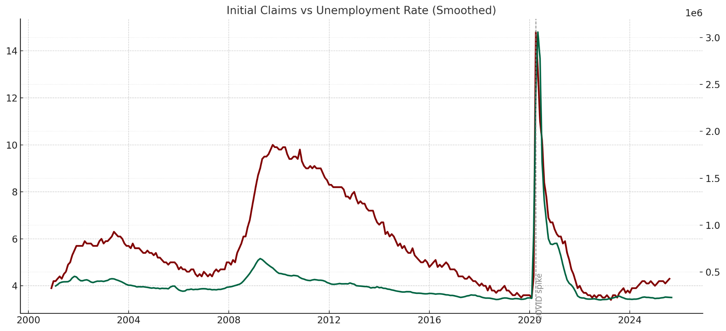
Exploratory Data Analysis (Trends)
ICSA & CCSA show extreme spikes during COVID layoffs
UNRATE jumps to 14.8% in 2020, declines with reopening
PAYEMS shows long-term job growth with dips in recessions
JTSJOL increases sharply post-2015 → strong labor demand
CPIAUCSL rises smoothly → inflation cycle
FEDFUNDS shows policy cycles, zero-lower bound (2008–2015)
red: initial claims, green: unemployement rate

Slide 7
Correlations & Feature Engineering
Feature Engineering Applied
Monthly averages for weekly claims (ICSA, CCSA)
Log transforms to smooth spikes in claims
Lagged PAYEMS (t-1) to capture leading job growth effects
Rolling averages (3-month) for unemployment persistence
Key Correlations
Job Openings (JTSJOL) shows a strong negative relationship with U-3 (−0.60), confirming that tighter labor markets reduce unemployment.
Initial & Continued Claims (ICSA, CCSA) show strong positive correlations with U-3 (0.55–0.72), indicating layoffs strongly drive unemployment.
Payroll Employment (PAYEMS) is strongly negatively correlated with U-3 (−0.65), meaning job growth precedes declines in unemployment.
CPI Inflation (CPIAUCSL) and Federal Funds Rate have moderate positive relationships with U-3 through monetary tightening and real wage effects.

Slide 8
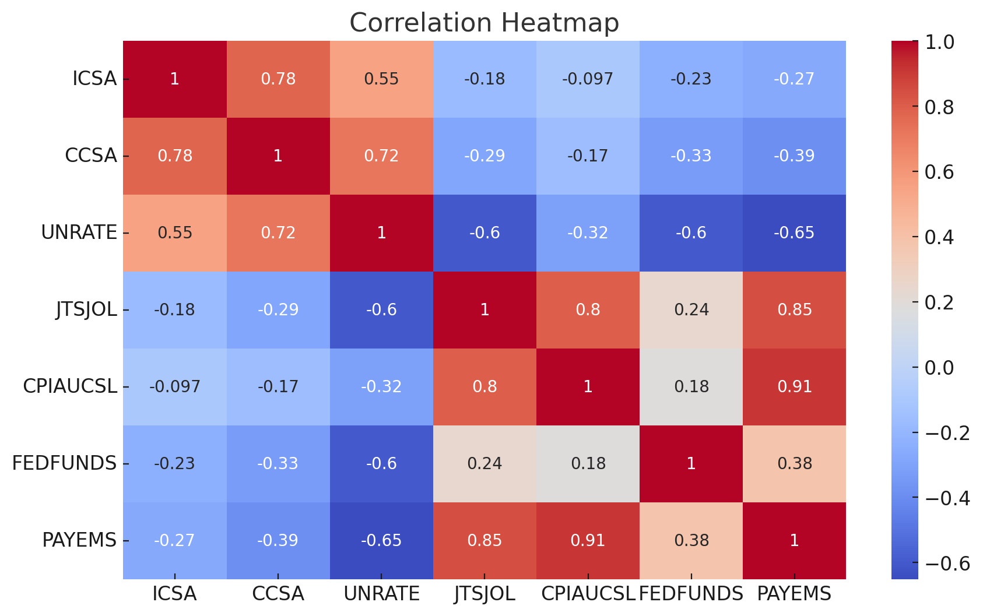
Correlations & Feature Engineering

Slide 9
Modeling Approach
Collected monthly indicators related to layoffs, payrolls, job openings, and unemployment trends
Created versions of these indicators using lags, percent changes, and moving averages to capture gradual labor-market shifts
Started with 20 macroeconomic predictors (lags, pct changes, moving averages)
Applied step-by-step Forward Selection using F-tests to choose significant variables that meaningfully improved forecasting and reduced error
Fit the final model on the full historical dataset and built a linear regression model
Verified model behavior using residual checks and normality diagnostics
Notes:
To do this, we collected monthly labor-market indicators such as layoffs, continued claims, payroll counts, job openings, and unemployment trends. We also created versions of these indicators that include lags, percent changes, and moving averages, because unemployment rarely moves suddenly

Slide 10
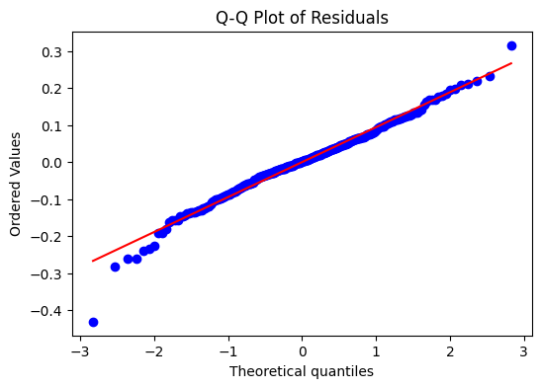
Final Model Specification
The final regression model includes ten predictors chosen through forward selection, capturing layoffs, continued claims, payroll dynamics, and smoothed unemployment trends.
Multicollinearity expected due to macroeconomic co-movement, but does not impede forecasting performance
The model’s errors behave as expected and is not showing signs of distortion or bias
Parameter Estimates: Coefficient signs behave as expected: rising layoffs push unemployment up, while stronger payrolls pull it down
Model explains broad cyclical behavior in unemployment without overfitting
Residuals are compared to a theoretical normal distribution, consistent with OLS error assumptions.
Notes:
Many indicators naturally move together, but this does not harm forecasting because the goal is accurate prediction, not isolating causality
The model’s errors behave as expected
he points lie very close to the straight line, which means the model’s errors behave the way we expect under linear regression. In other words, the model is not showing signs of distortion or bias.

Slide 11
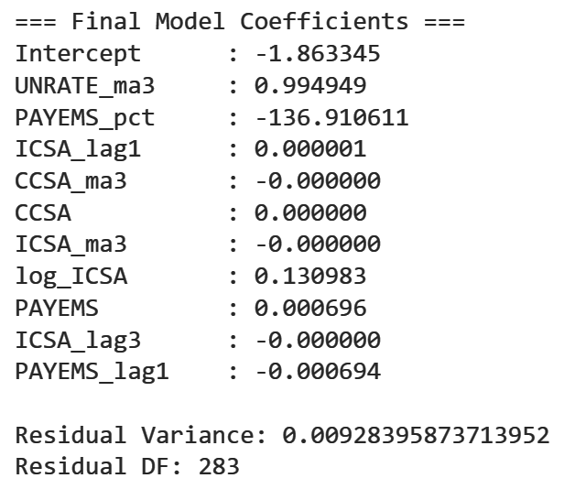
Model Equation
Why we repeated variables
Different transformations capture different economic behaviors. Levels show long-term trends, percent changes capture acceleration, and lags capture delayed effects.
Labor-market indicators move slowly, so unemployment depends on both current and past values of payrolls and claims.
Each form contributed unique predictive signal during forward selection, even if the variables are related.
We acknowledge multicollinearity, but since the goal is forecasting, the model can still be effective even with correlated predictors.

Slide 12
Forecast for December 2025
Using the final model, we applied the most recent macroeconomic data (as of Nov 2025) to forecast the December 2025 U-3 unemployment rate
The model forecasts a U-3 unemployment rate as 4.23%, which aligns with current labor-market cooling trends.
The forecast provides a quantitative reference point for interpreting the December labor release
The prediction reflects combined effects of layoffs, payroll levels, and smoothed unemployment trends captured in the model
Notes:
This estimate lines up with what we’ve been seeing lately: layoffs have risen modestly, payroll growth has cooled, and unemployment has been trending slowly upward.
So a prediction in the low fours is consistent with those patterns.`

Slide 13
Model Evaluation: Key Metrics
Metric | Value | What does this mean?
Residual Variance | 0.0093 | Measures how much predictions differ from actual values. Small number like 0.0093 means predictions are very close to real data
Mean Absolute Error | 0.0711 | Model’s predicted U-3 rate differs from the actual rate by 0.0711, demonstrating high accuracy
Root Mean Square Error | 0.0945 | Gives more weight to larger errors. Low value shows model rarely makes large prediction errors
R-squared | 0.9977 | Model explains 99.77% of the variability in U-3 unemployment rates, indicating an excellent fit
Adjusted R-squared | 0.9976 | Adjusted for number of predictors, model still captures nearly all variation in U-3 rates, confirming reliability
Notes:
Residual Variance: Average Squared Error
MAE: average magnitude of errors
RMSE: squares the errors, takes the mean and then takes root
R squared: proportion of variance in target predictable from predictor variables
Adjusted R-squared: Penalizes model for adding unnecessary predictors
R² = 1 - (Sum(Residual²) / Sum((Actual - Mean)²))
Adjusted R² = 1 - (1-R²) * (n-1)/(n-p-1)

Slide 14
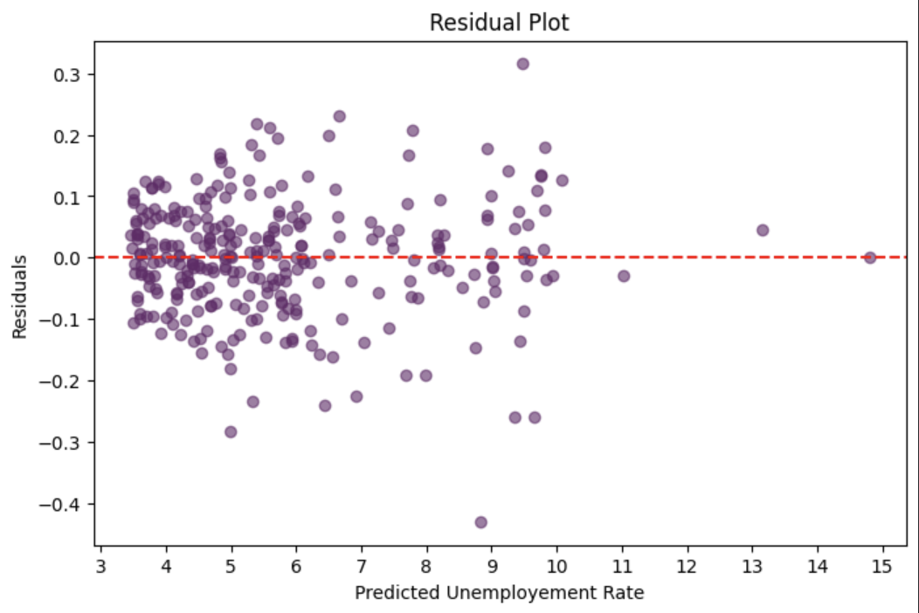
Residual Analysis
Residuals mostly scattered around zero, indicating the model fits the data well
Spread of residuals is fairly consistent, with just a little more variation at higher predicted values
Few points are farther from zero, indicating occasional larger errors
Generally, residuals are small, showing that model predicts the unemployment rate very accurately

Slide 15


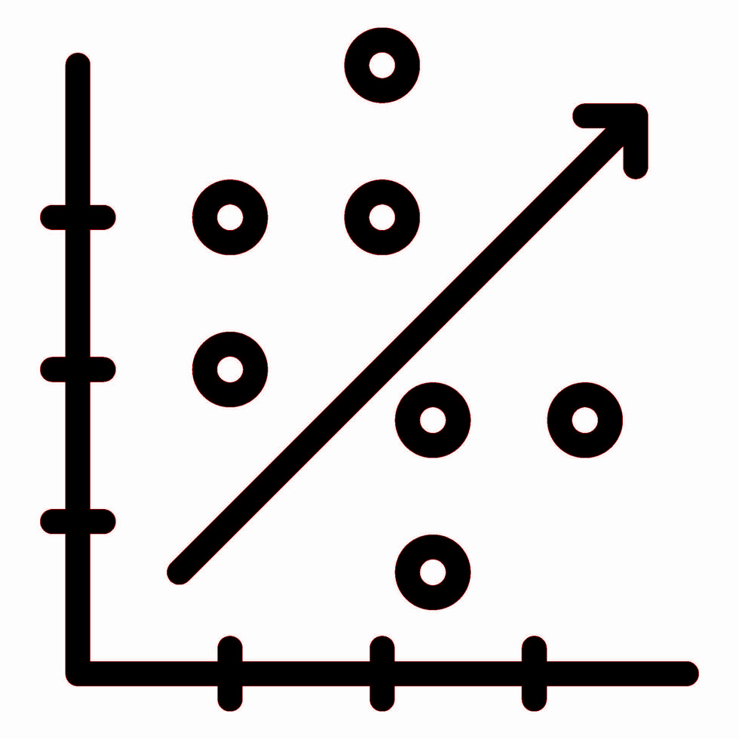
Project Limitations
Extreme Events
Unusual events like COVID-19 or past recessions create spikes that may distort predictions
Limited Predictors
Model uses selected indicators, doesn’t include factors like policy changes (e.g. labor regulations) or sectoral employment shifts (e.g. decline in manufacturing)
Linear Relationships Assumed
Relationships between predictors and unemployment are assumed linear, might oversimplify real economic dynamics

Slide 16
Summary
Our linear regression model accurately predicts the December 2025 U-3 unemployment rate at 4.23%, closely reflecting current labor market trends
High R² (0.9977) and low error metrics (MAE 0.0711, RMSE 0.0945) indicate excellent historical fit and predictive reliability
Transformations like lagged variables, rolling averages, and logarithms help reveal patterns in unemployment
Extreme events, limited predictors, and linearity assumptions limit model’s accuracy, so the model serves as a general guide rather than an exact prediction

